Slide 1
Lecture 11:
Coordination and Agreement
Central server for mutual exclusion
Election – getting a number of processes to agree which is “in charge”
CDK4: Chapter 12 (esp. Section 12.3)
CDK5: Chapter 15 (esp. Section 15.3)
TVS: Chapter 6 (esp. Section 6.5)

Slide 2
(Distributed) Mutual exclusion
In a single machine, you could use semaphores to implement mutual exclusion
How to implement semaphores?
  Inhibit interrupts
  Use clever instructions (e.g. test-and-set)
On a multiprocessor shared memory machine, only the latter works
On machines which don’t even share memory, need something different
The simplest solution is a central server
Client requests token on entry, and releases it on exit
Server queues requests when it has no token
COMP28112 Lecture 11

Slide 3
Server managing a mutual exclusion token for processes (CDK Fig 12.2)
Server
Queue of
requests
4
2
3. Grant
token
1. Request
token
2. Release
p
p
token
4
1
p
p
2
3
COMP28112 Lecture 11

Slide 4
Alternatives …?
The server is a single point of failure
Also possibly a bottleneck for the system
However many very clever, more distributed algorithms are generally worse in terms of number of messages, and have other problems!
COMP28112 Lecture 11

Slide 5
Election – why?
Need a distinguished process:
To implement locking/mutual exclusion
Or to coordinate distributed transactions
Election is also a good introduction to what is involved in getting processes in a distributed system to cooperate.
COMP28112 Lecture 11

Slide 6
Two Algorithms
A ring-based election algorithm
The bully algorithm
Same scenario:
A fixed set of processes: p1 … pn
Want to elect the process with the largest identifier – where identifiers are totally ordered, e.g. <1/(load+1), i>
COMP28112 Lecture 11

Slide 7
Requirements
Want all processes to agree who is elected i.e. they need to learn the result of the election
Any process can initiate an election – so there may be more than one happening at any one time ….
COMP28112 Lecture 11

Slide 8
Ring-based algorithm
Arrange the processes in a logical ring – so each knows which is next in order
Assume no failures and system is asynchronous
Initially every process is a non-participant
Initiating process changes itself to be a participant and sends its identifier in an election message to its neighbour
COMP28112 Lecture 11

Slide 9
Action on receiving election message
Receiver compares its own identifier with that in the message
If the identifier in the message is larger it forwards the election message unchanged
Otherwise if receiver is already a participant, it discards the message
Otherwise it forwards the message, but with its own identifier
It is now a participant
COMP28112 Lecture 11

Slide 10
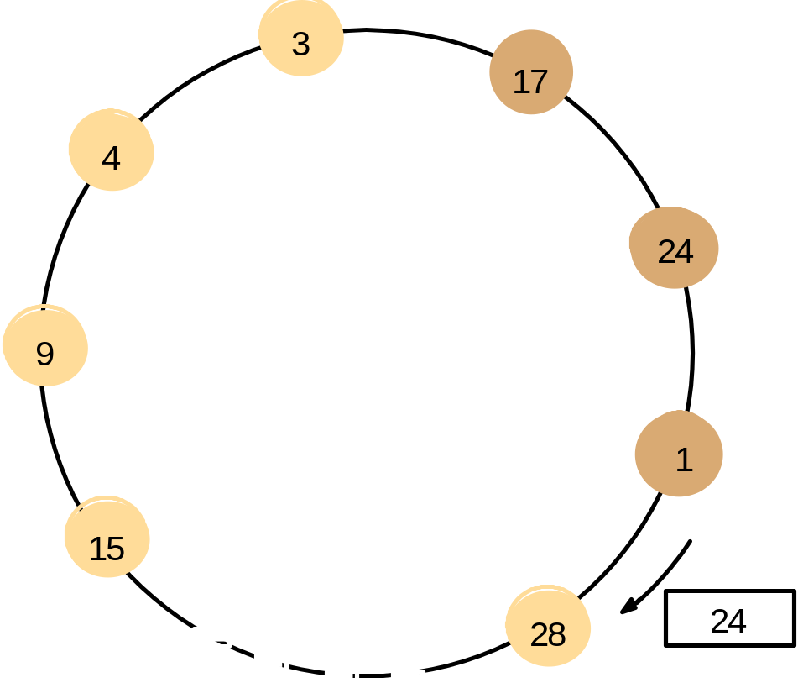
A ring-based election in progress
(CDK Fig. 12.7)
Note: The election was started by process 17. The highest process identifier encountered so far is 24. Participant processes are shown darkened
COMP28112 Lecture 11

Slide 11
Until …
If the identifier in the received election message is that of the receiver, that process has just been elected!
It now sends an elected message round the ring – to tell everyone
Now each receiver notes the result, passes it on, and resets to non-participating
COMP28112 Lecture 11

Slide 12
Evaluation
How many messages are sent?
Worst case is when process elected is just before one which initiated election
Then there are 3n–1 messages
Toleration of failures: very limited – in principle can rebuild ring, but ….
Difficult to add new processes to ring too
COMP28112 Lecture 11

Slide 13
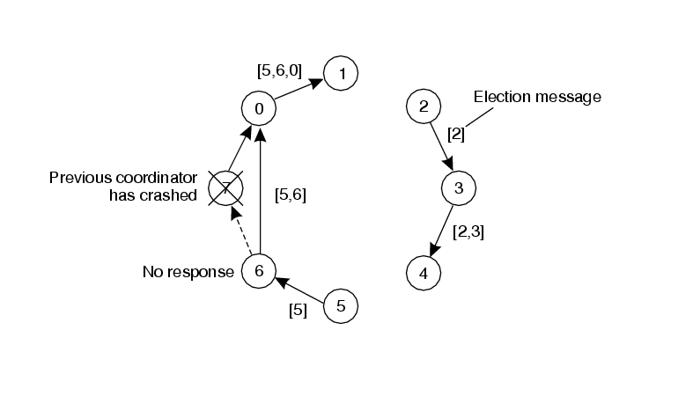
TVS, Figure 6.21 – two processes initiate election
COMP28112 Lecture 11

Slide 14
Bully algorithm
(Garcia-Molina 1982)
Designed for slightly different situation
Processes may crash (though messages are assumed reliable)
A process knows about the identifiers of other processes and can communicate with them
System is synchronous – it uses timeouts to detect process failure
COMP28112 Lecture 11

Slide 15
Three types of message
An election message – sent to initiate an election
An answer message – sent in response to an election message
A coordinator message – sent to announce the identity of the winner of the election
COMP28112 Lecture 11

Slide 16
Two timeouts
If no reply is received in time T, assume that the reply sender has crashed
If the initiator of an election doesn’t learn who won in time T + T’ it should begin another election – a process must have crashed in such a way as to mess up this one
COMP28112 Lecture 11

Slide 17
Initiating election
Process sends an election message to all processes with higher identifiers than itself
Those that have not crashed will respond with an answer message (within the timeout period) – and the initiating process can then sit back and wait for a coordinator message
COMP28112 Lecture 11

Slide 18
Receiving an election message
Any process receiving an election message should send an answer back to the sender
It should then initiate its own election – by sending an election message to each process with a larger identifier than itself
Unless it has recently done that, and had neither a coordination reply nor a timeout (T’).
A process with no answering process above it should consider itself elected
It should then send a coordinator message to all lower processes ….
COMP28112 Lecture 11

Slide 19
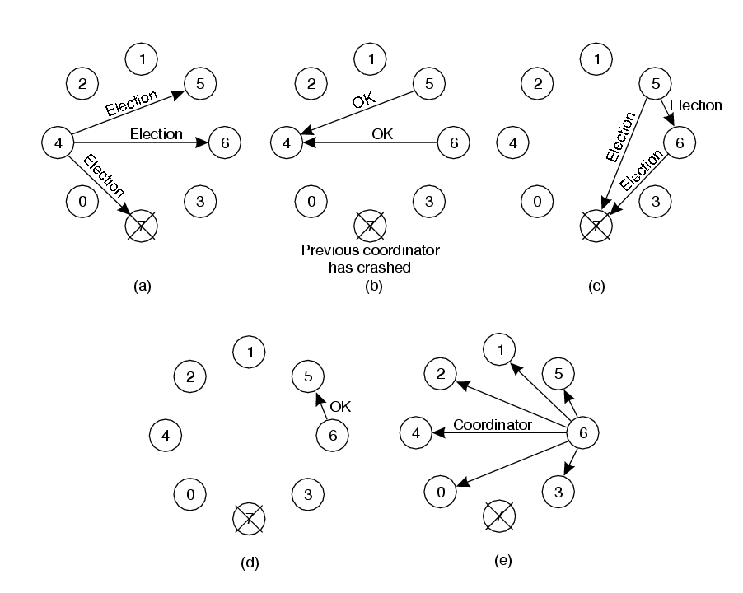
TVS, Figure 6.20
COMP28112 Lecture 11

Slide 20
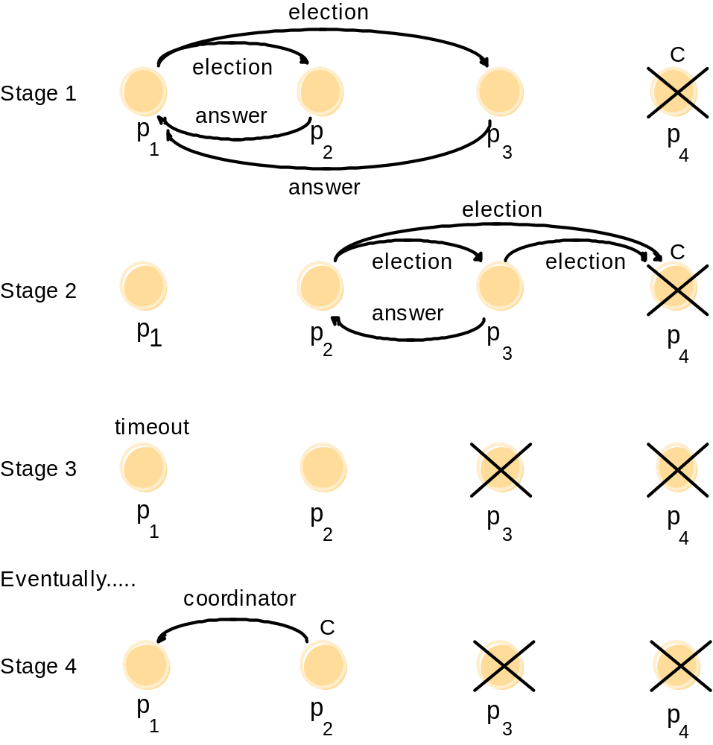
The bully algorithm (CDK Fig. 12.8)
The election of coordinator p₂,
after the failure of p₄ and then p₃
COMP28112 Lecture 11

Slide 21
Evaluation
Need timeouts to be realistic
Problem if process restarts and elects itself ….
No of messages depends on which process initiates – the higher the process the smaller the number of messages! If the lowest process initiates, O(n^2) ….
Exercise: 2015 exam, question 3d
Next: Dealing with failures…
COMP28112 Lecture 11

